Slide 1

What’s Up With This Water?
Sagan´s Stellar Scripters

Slide 2
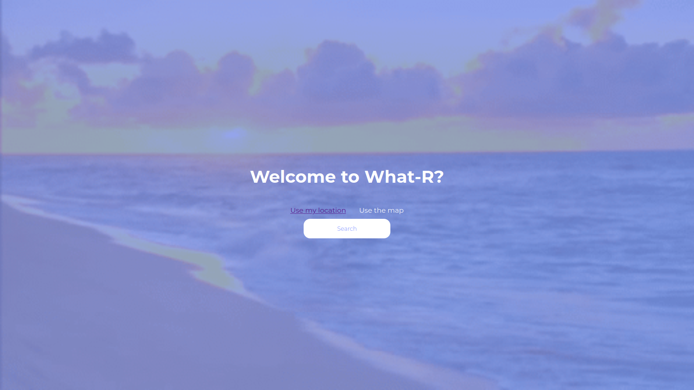


Introduction
Humans love the sea, the sun, and those piña coladas under the sun.
The ocean, Earth's largest and least explored habitat, covers over 70% of our planet.
Less than 5% of the vast ocean has been explored, leaving us with limited knowledge of its depths.

Slide 3
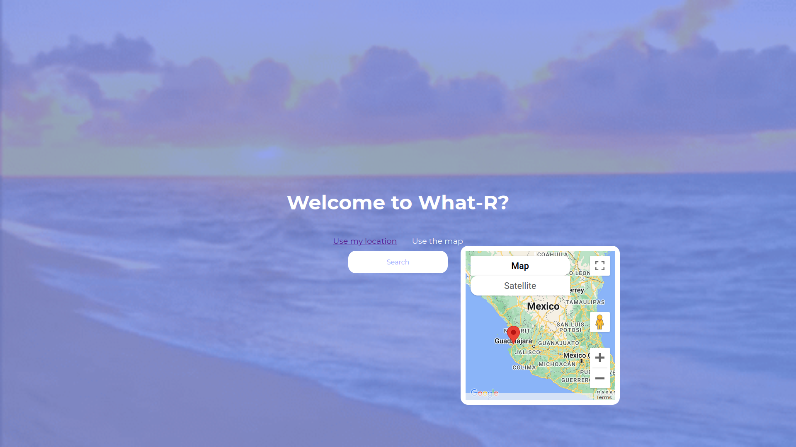
Marvels Near the Surface
Whales, majestic and awe-inspiring.
Sea turtles, fascinating creatures.
Dolphins, playful and enchanting.
The beauty of marine life never ceases to amaze us.

Slide 4
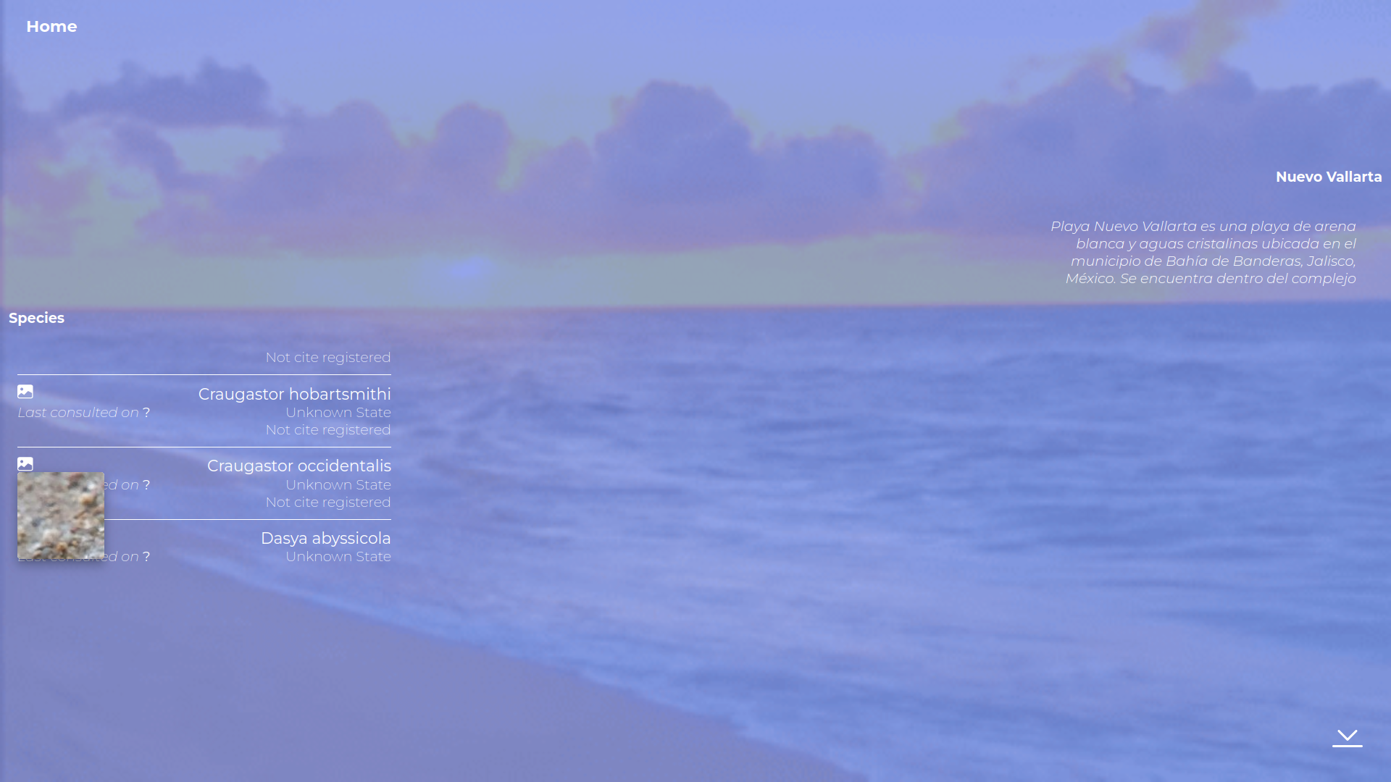
Hidden Dangers
Some ocean inhabitants can be dangerous to humans.
Mantas and venomous fish pose risks.
Lack of knowledge about these species has led to accidents.

Slide 5
The Need for Knowledge
We must acknowledge our limited understanding.
Ocean exploration is vital for safety.
Responsible beachgoers need reliable information.

Slide 6
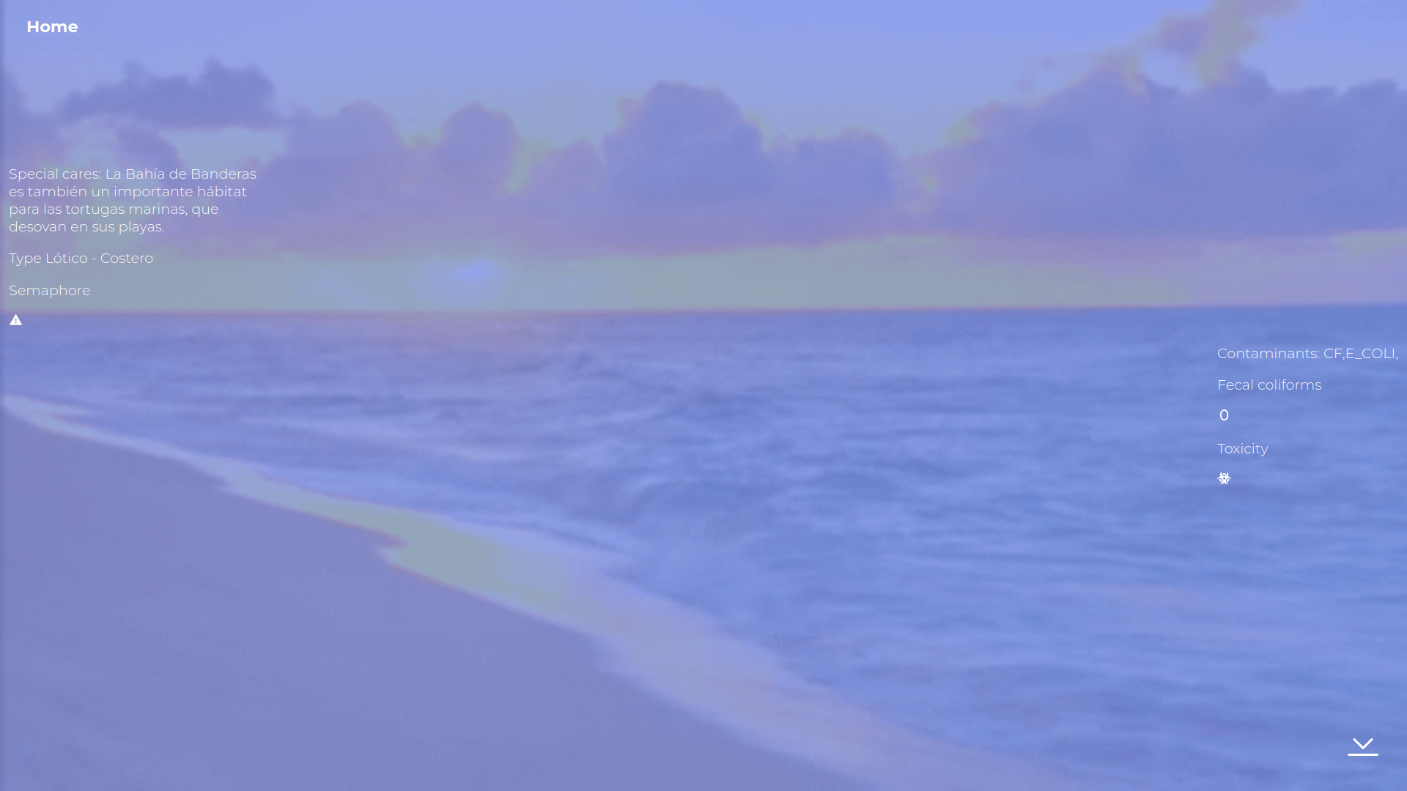
Introducing What-R
What-R, your ocean companion.
Scan a QR code on the beach.
Instantly access information about marine species in the area.
Learn about potential risks and safe practices.

Slide 7
Ensuring Safety and Enjoyment
What-R prioritizes your safety and enjoyment.
Explore the wonders of the ocean worry-free.
Remember, What-R is here to answer your question: "What's in the water?"

